Slide 1
Client Side Scripting
Functions

Slide 2
Functions
We have already used and created some functions in our practice
You should have noticed that there are two types of functions:
Built-In: - These are pre defined functions which do a particular task - Example parseInt() and alert() - There are methods which return a value e.g. parseInt() returns a number value. - Then there are methods which simply do an action and do not return a value e.g. alert() - This depends on how they were defined - The developer would only need to call such functions - Though it is important that the developer has knowledge on what the built-in methods do
User-Defined:
- Functions which are defined and created by the developer - Normally these include functionality which is required by the specific system - Making it possible to extend the vocabulary that we have

Slide 3
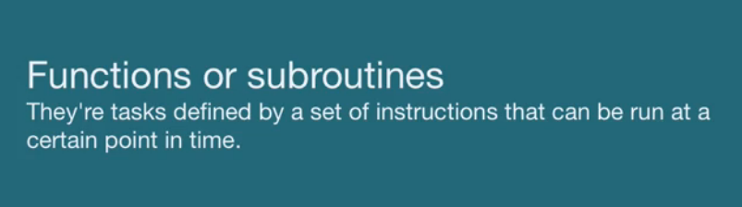
Functions

Slide 4
Functions
Functions consist of a series of statements that have been grouped together to perform a specific task
If different parts of a script repeat the same task, you can reuse the function and so avoid code redundancy
Take a pocket calculator as an example:
It performs lots of basic calculations, such as addition and subtraction
Many also have function keys that perform more complex operations
Functions use curly brackets to encapsulate a block of code that performs a certain task

Slide 5
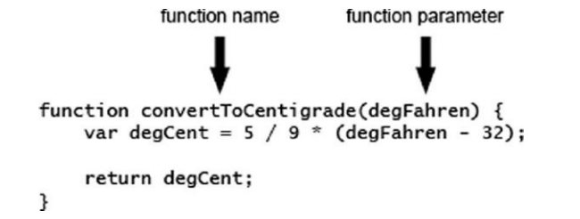
Creating Functions

Slide 6
Creating Functions
Every defined function in JavaScript must be given a unique name for that particular page
The name is written immediately after the function keyword
Function names should be meaningful so as to help you understand/remember better what the function does when you use/see them in your code later on
Same as for variables, names which can be used for functions are limited. For example, reserved words cannot be used. The following defined functions would be incorrect:
if()
while()
var()

Slide 7
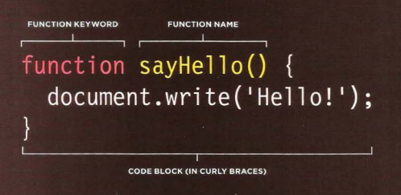
Declaring Functions

Slide 8
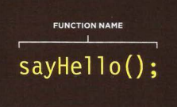
Calling a Function
To call / invoke a function, you simply need to type in the function identifier, brackets and semicolon

Slide 9
Calling a Function
Creating a function does not mean that you are using it any time yet!
We invoke functions when we need them
Otherwise, they will never be executed
We invoke functions by using their assigned name followed by the respective inputs/parameters that they might accept within a pair of round brackets.
If you invoke/call a function having a return statement, you need to assign it to a variable. Otherwise, the returned value would be lost
var myTemp = convertToCentigrade(212);

Slide 10
Functions Parameters
A function can have zero or more parameters
Parameters are written inside the brackets after the function’s name
A parameter is just an item of data that the function needs to be given in order to do its job
Even if a function has no parameters, you must still put the open and close brackets after its name.
For example, the top of your function definition must look like the following:
function myNoParamFunction()
You then write the code, which the function will execute when called on to do so.
All the function code must be put in a block with a pair of curly braces.

Slide 11
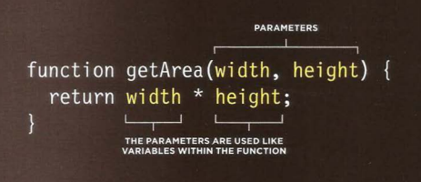
Declaring Functions
That need information

Slide 12
Functions Return
Functions also enable you to return a value from a function to the code that called it
The return statement is used to return a value
In the example function given earlier, convertToCentigrade(), you return the value of the variable degCent, which you have just calculated
You don’t have to return a value, but it’s important to note that every function returns a value even if you don’t use the return statement
Functions that do not explicitly return a value—that is, return a value with the return statement—return undefined

Slide 13
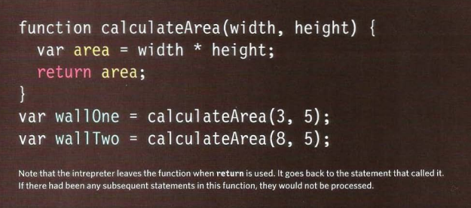
Getting a Single Value out of a Function

Slide 14
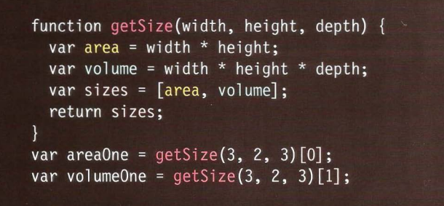
Getting a Multiple Values out of a Function
We will be revising arrays later on in the course.

Slide 15
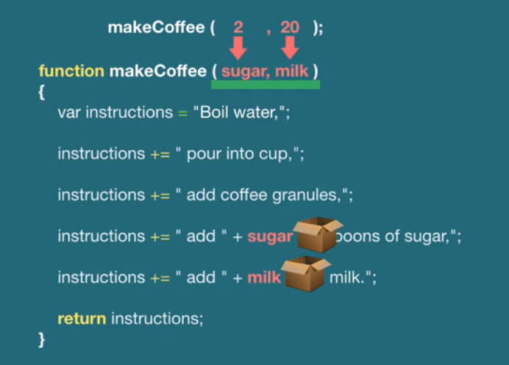
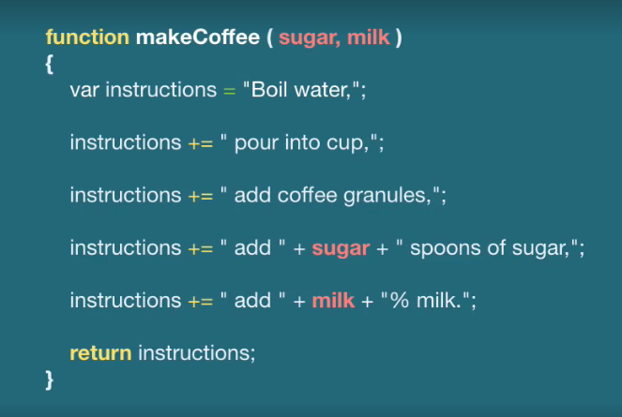
Functions
Notes:
No need to write different functions for different amount of sugars and milk
Try with Console.log();

Slide 16
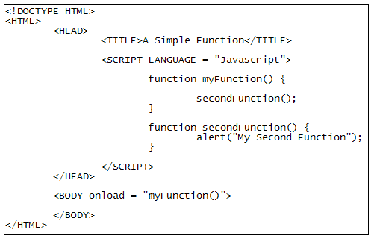
Functions Calling Other Functions
One function can also call another into action
You don't want one giant function that does everything, so the best practice is to have lots of smaller ones doing specific things
Example a function that gets values from a form when a button is clicked would need to check things like valid email address, or ticked check boxes. This would be easier if the functionality is split into steps.

Slide 17
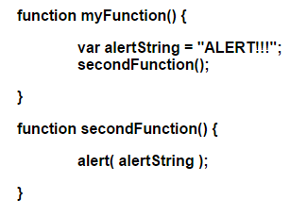
Functions Variable Scope
The location where you declare a variable will affect where it can be used within your code. If you declare it within a function, it can only be used within that function. This is known as the variable's scope.
No. Since the variable alertString has the scope of the myFunction() function
Will this code work?

Slide 18
Functions Local Scope
The problem with the previous example is having the variable alertString local to the myFunction() function. This is called Local Scope
When a variable is created inside a function, it can only be used and seen within that function
It is called a local variable or function-level variable
It cannot be accessed outside of the function in which it was declared in
The interpreter creates local variables when the function is run, and removes them as soon as the function has finished its task.
This means that:
If the function runs twice, the variable can have different values each time
Two different functions can use variables with the same name without any kind of naming conflict

Slide 19
Functions Global Scope
A variable created outside of a function, can be used anywhere within the script
It is called a global variable and has global scope
Global variables are stored in memory for as long as the web page is loaded into the web browser
This means they take up more memory than local variables
Global variables also increase the risk of naming conflicts
For these reasons, you should use local variables wherever possible

Slide 20
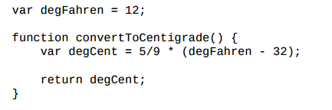
Functions Global Scope
In this code, the degFahren variable is a global variable because it is created outside of a function, and because it is global, it can be used anywhere in the page
The convertToCentigrade() function accesses the degFahren variable, using it as part of the calculation to convert Fahrenheit to centigrade
This also means you can change the value of a global variable

Slide 21
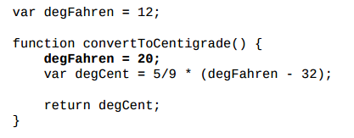
Functions Global Scope
This new line of code changes the value of degFahren to 20; so the original value of 12 is no longer used in the calculation
This change in value isn’t seen only inside of the convertToCentigrade() function. The degFahren variable is a global variable, and thus its value is 20 everywhere it is used
Thus, we can see another problem with global variables can be easily and unintentionally modified

Slide 22
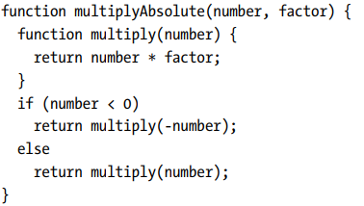
Nested Scope: Functions declared within other functions
In JavaScript, we can declare functions within other functions.
There can be any number of stacked (or nested) variable scopes.
Functions defined inside other functions can refer to the local variables in their parent function, functions defined inside those inner functions can refer to variables in both their parent and their grandparent functions, and so on.

Slide 23
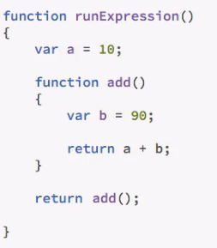
Nested Scope: Functions declared within other functions
Is this code correct?

Slide 24
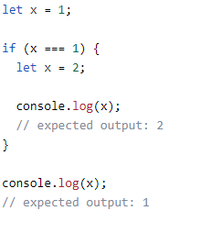
let keyword
The previous applies when declaring variables using the var keyword.
The let keyword allows you to declare variables that are limited in scope to the block, statement, or expression on which it is used.
This is unlike the var keyword, which defines a variable globally, or locally to an entire function regardless of block scope.

Slide 25

Practice
Access Moodle and work out Worksheet 6

Slide 26
References
Johnson, G. (2013). Programming in HTML5 with Javascript and CSS3. United States of America: Microsoft Press.
McPeak, J. (2015). Beginning JavaScript, 5th Edition (5 ed.). Wrox.
Haverbeke, M. (2011). Eloquent JavaScript: A Modern Introduction to Programming. (S. Yang, Ed.) San Francisco: William Pollock.
McFarland, D. S. (2014). JavaScript & jQuery (3 ed.). United States of America: O’Reilly Media, Inc.
Duckett, J. (2014). JavaScript and JQuery Interactive Front-End Web Development (1 ed.). Wiley.

